Slide 1
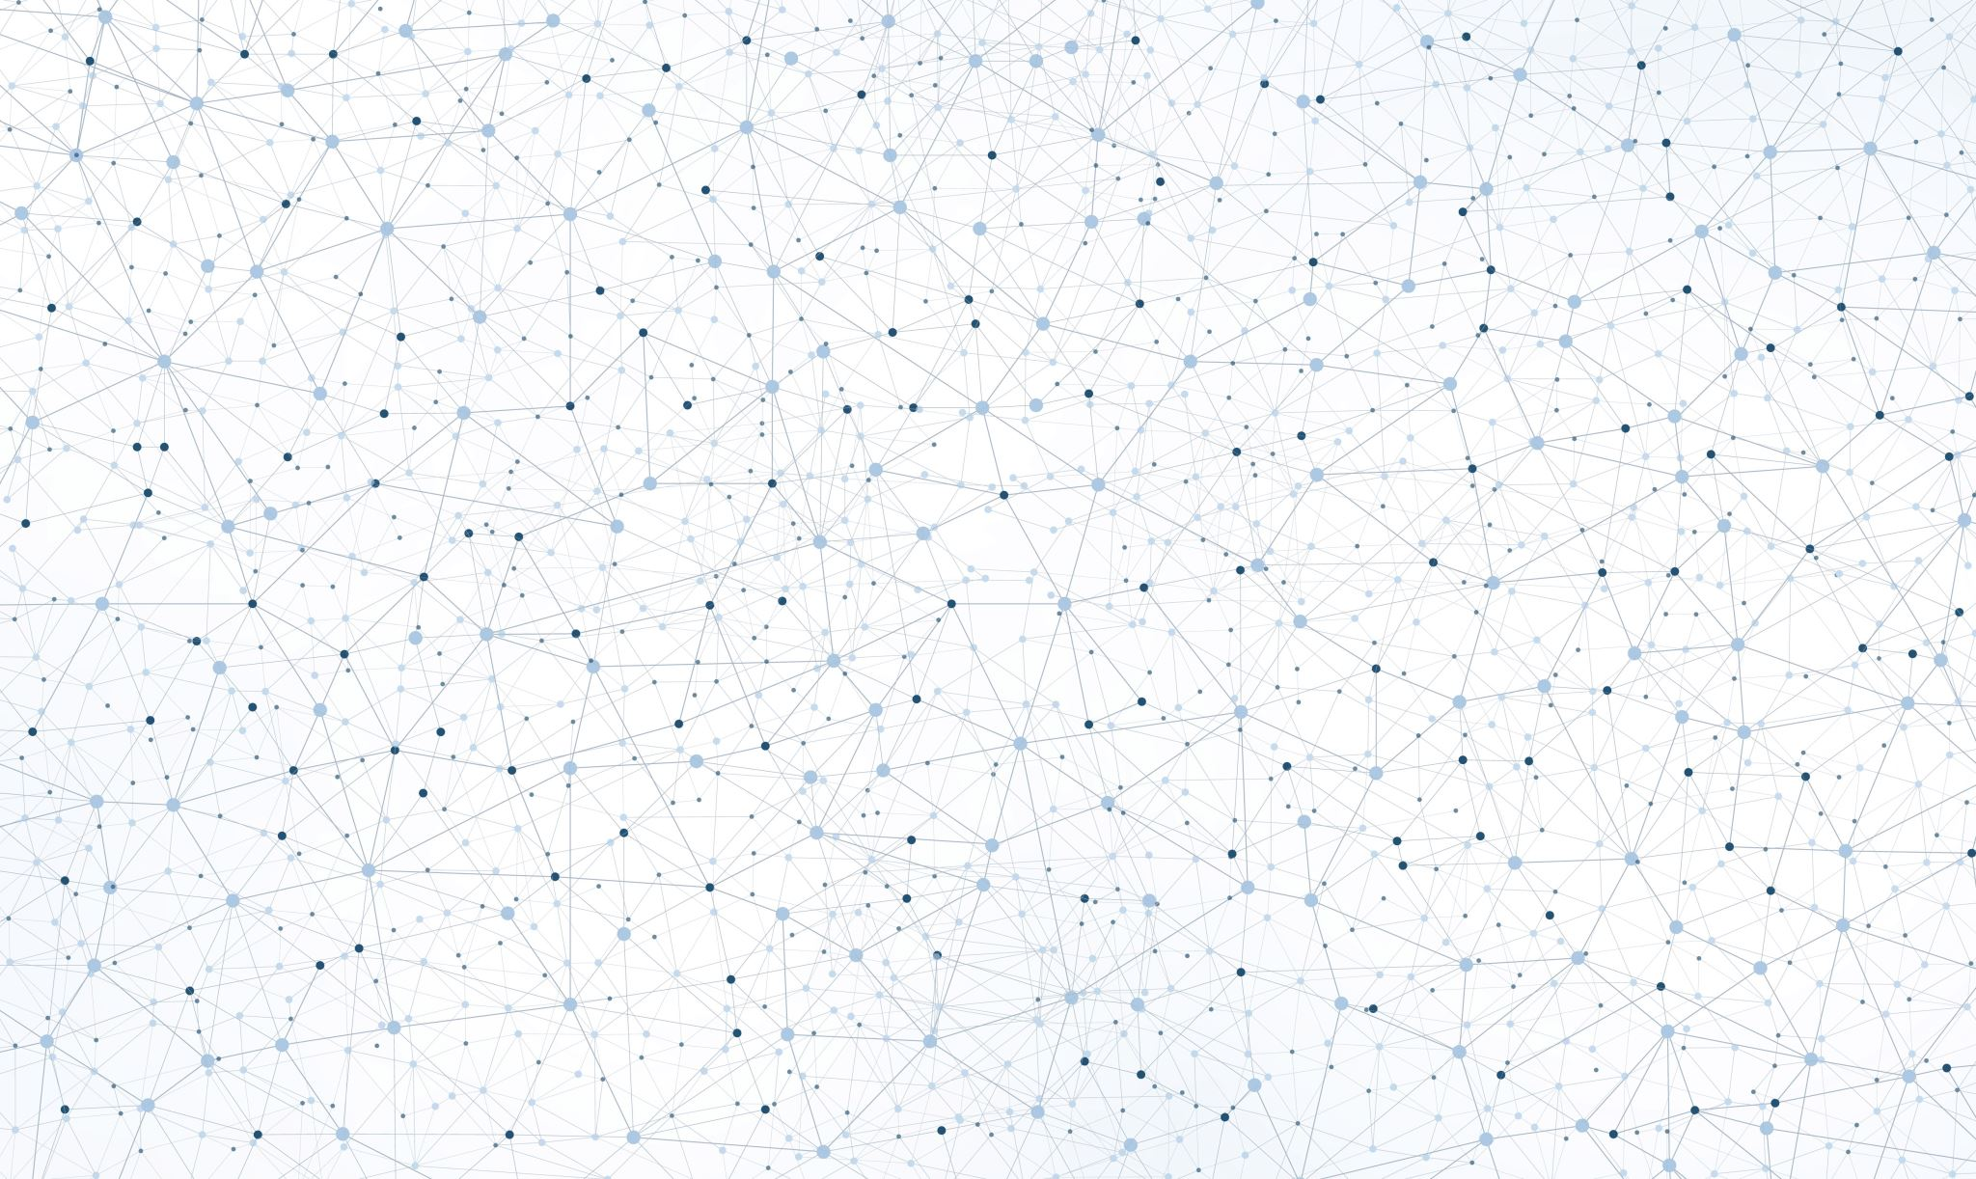
Introduction to Software Development
Week 1 Day 2
Led by:
Emily Crose
Oakland University
Notes:
Include VLANs?

Slide 2
Contact info
ecrose@oakland.edu

Slide 3
Admin Items
Absences
Two allowed absences (with courtesy email to the instructor)
Quiz at the end
YOU MUST TAKE THE QUIZ!
Notes:
These are admin items that are required by Stellantis, these are not my rules. You MUST take the quiz! If you don’t take the quiz, you won’t get credit for the class.

Slide 4





Previous Session Recap

Slide 5


Question or Clarifications?

Slide 6

Networking

Slide 7

Notes:
To better understand networking, let’s look at a similar system we use for delivering information from one place to another. Let’s look at the US Postal system.
Can someone explain the step-by-step process for mailing a letter?

Slide 8
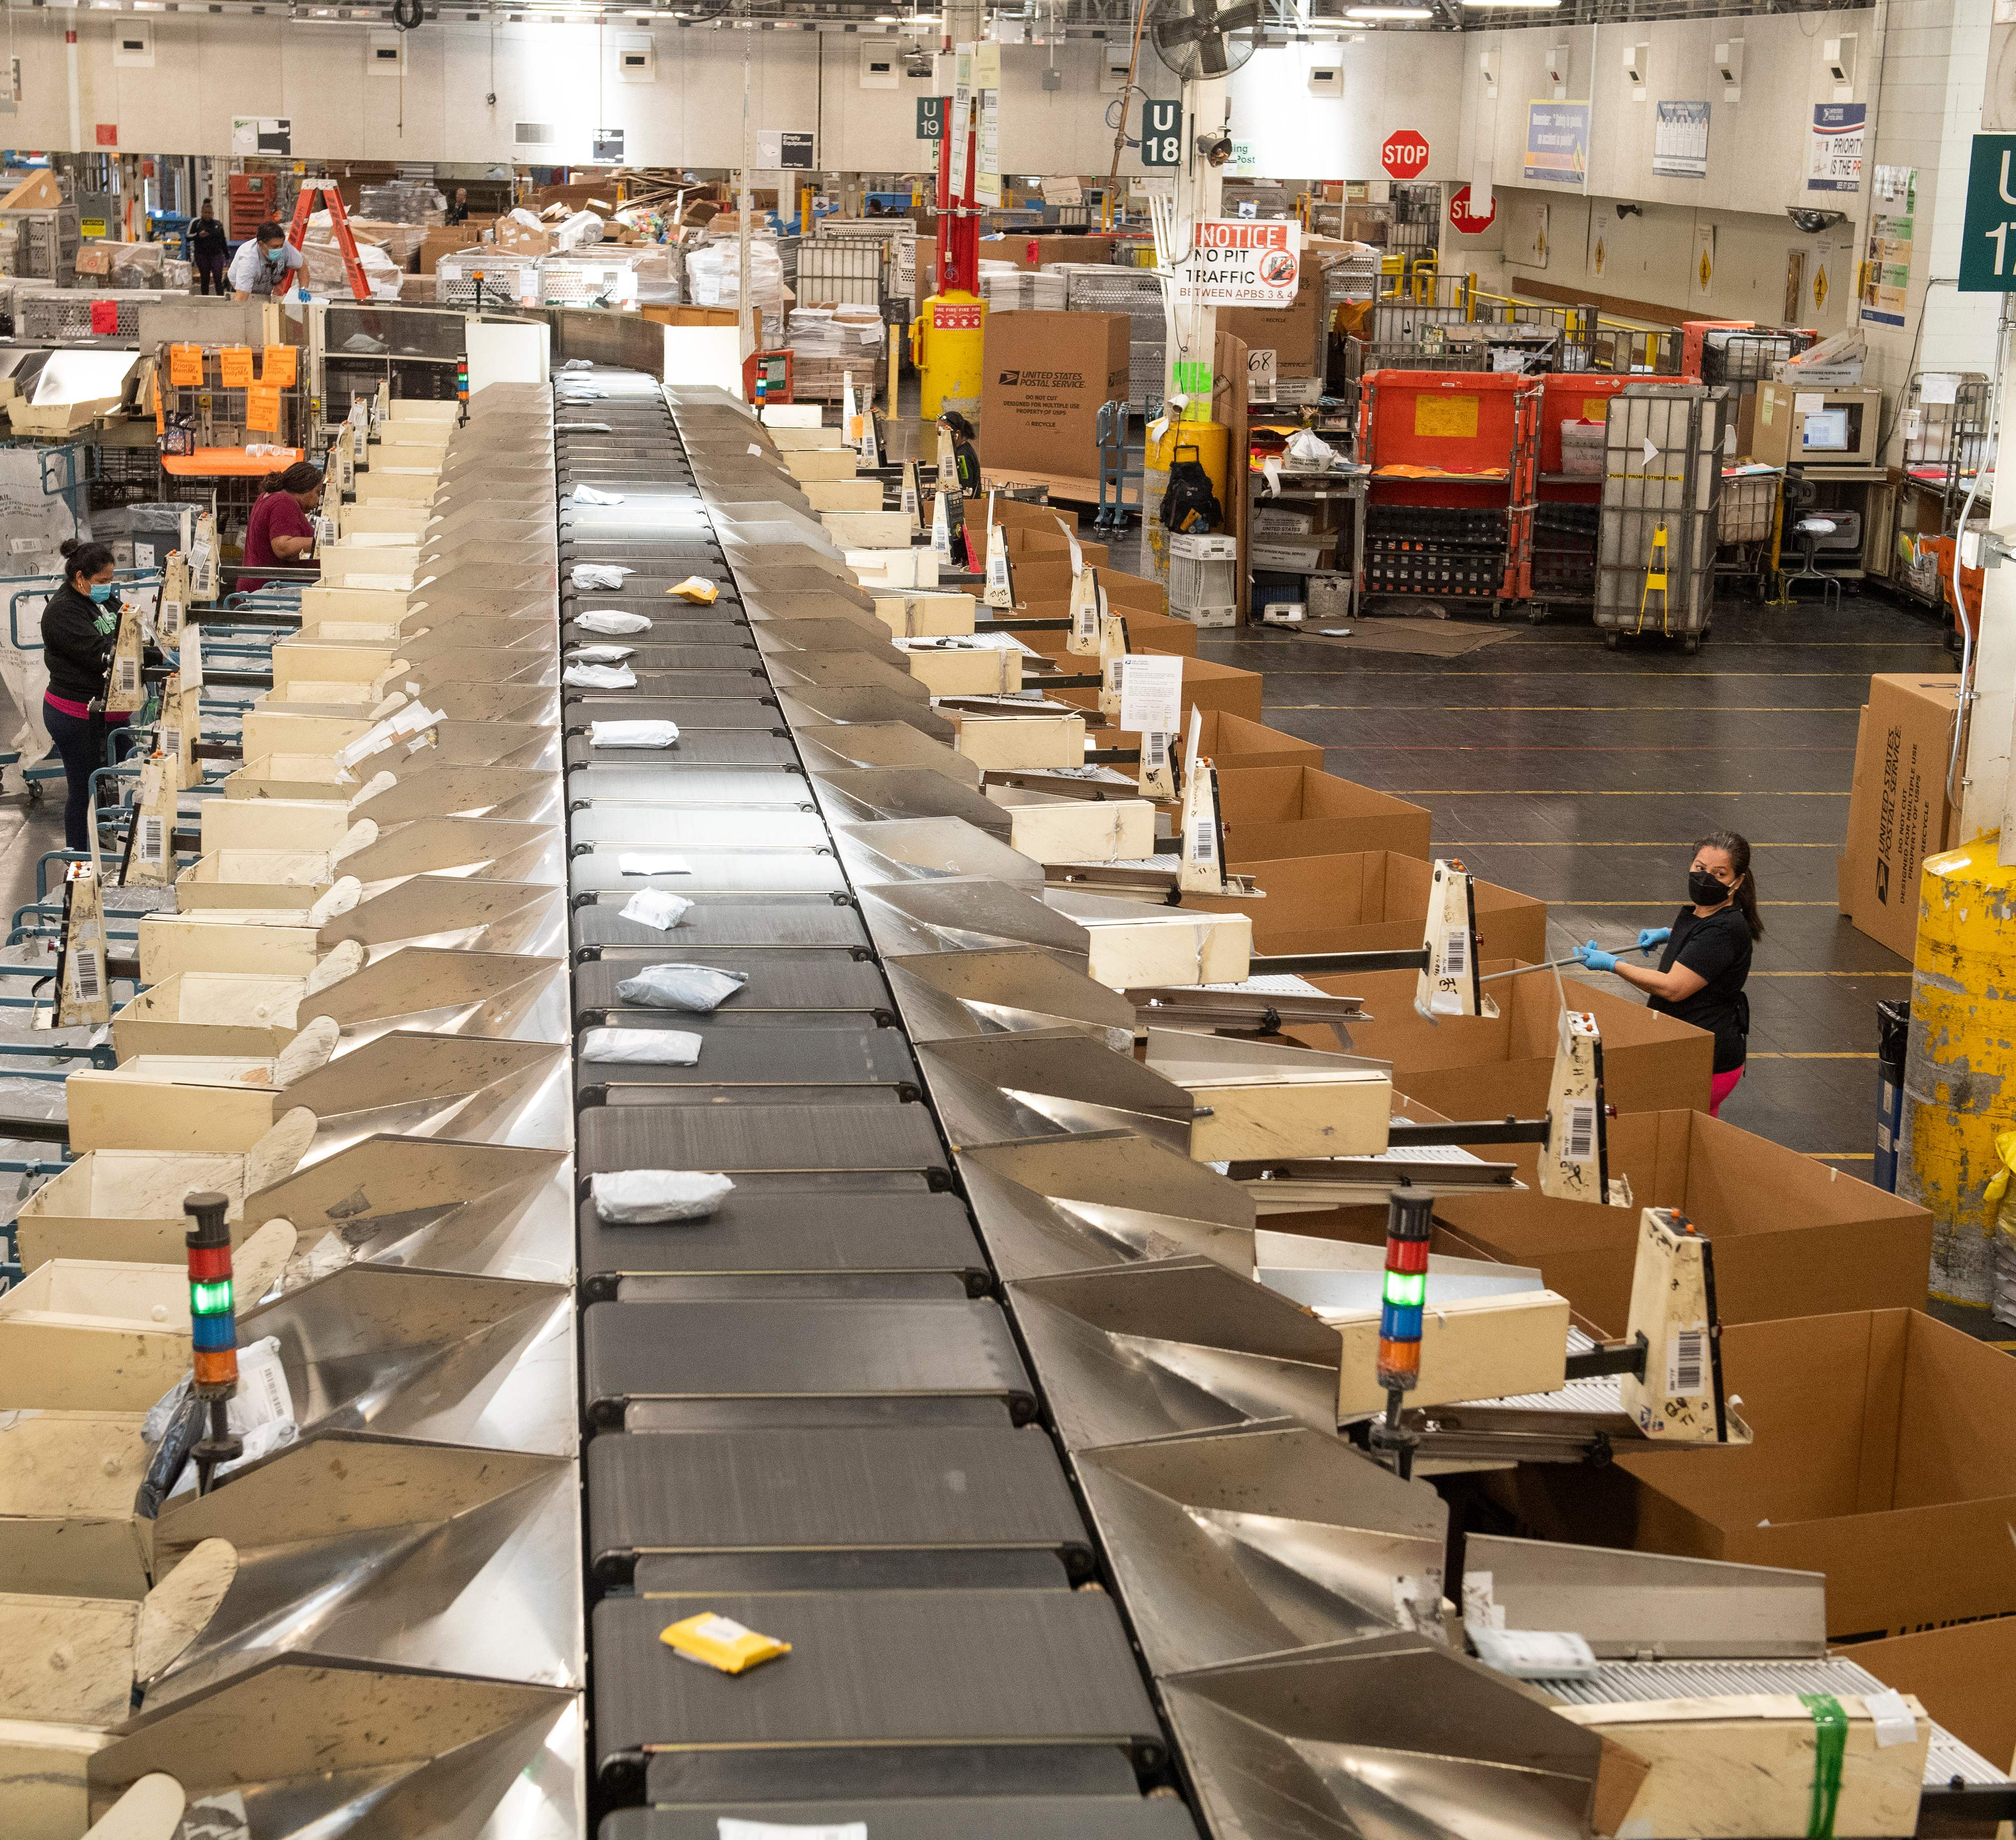
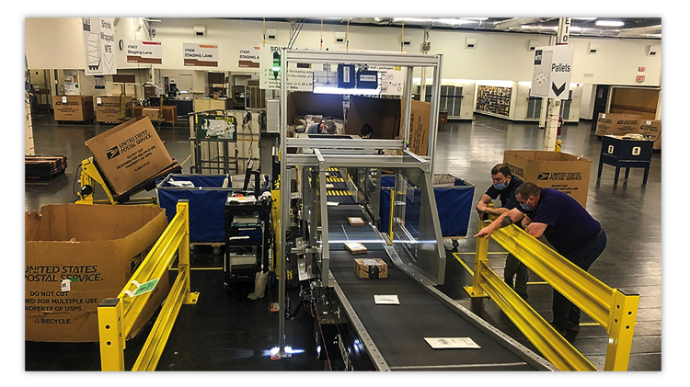
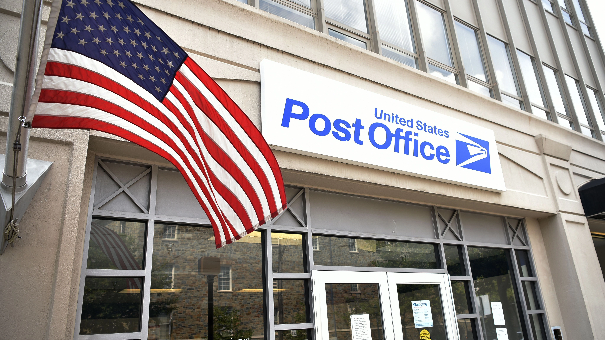
Notes:
When we go to mail a letter, we need many things to successfully get that letter from one place to another. We need a post office location, and inside that location, we need workers who can take that letter. That worker will process some information about where the letter is going, and they will put it through the machines, which will then start sorting our letter along with all of the other mail in the postal system.
Once inside the system, the mail will go through all sorts of machines from scanners to mail sorting machines, all carried by conveyor belts and put on trucks, where the mail will be taken to another location, where the process will happen all over again. We will consider most of these components to be physical components.

Slide 9
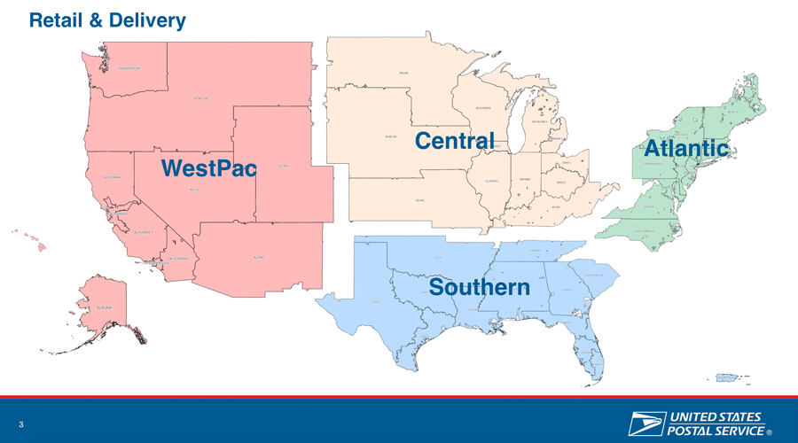
Notes:
The mail system as the post office sees it is broken down into multiple regions. This is a logical understanding of location that is needed to conceptualize a better way of transferring mail from place to place.

Slide 10
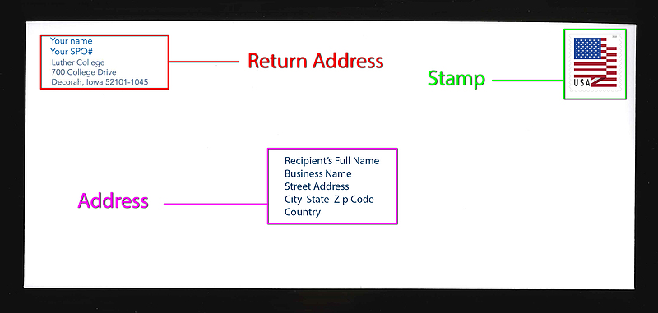
Notes:
Now, let’s talk about the letter itself. We need a few pieces of information on our letter to successfully get it into the mail system, and for it to be processed by the machines we know the mail will go through.

Slide 11
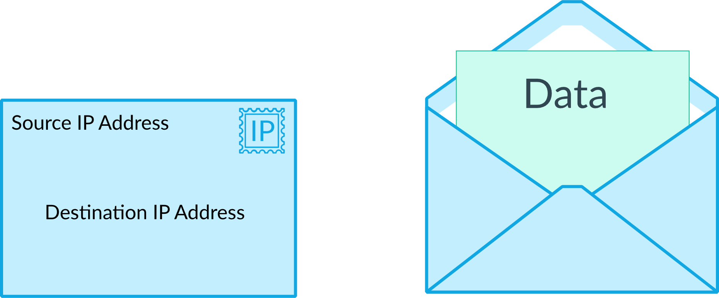
Notes:
Just like when we send our letter, we will need to put some basic information on our data. In this case, we will need a source IP and a destination IP.

Slide 12
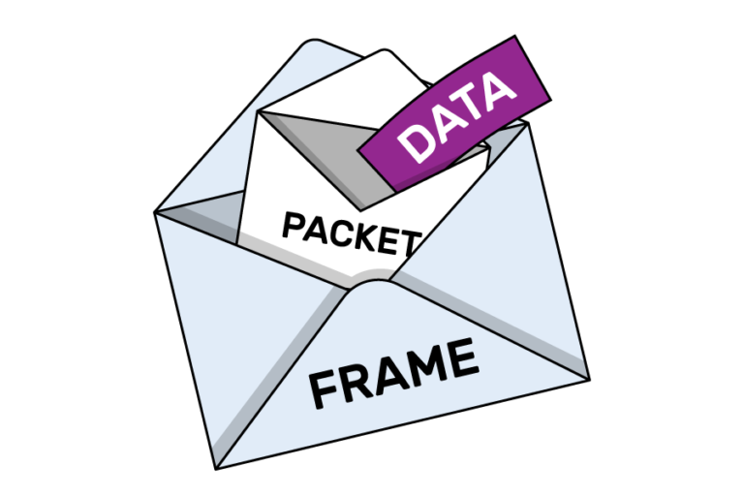
Packets
Notes:
In the last slide, we saw the data go into the packet envelope, and in networking, we then put that packet envelope into a frame envelope.

Slide 13

What Does Your Home Network Look Like?
Notes:
Let’s have a quick discussion. What does your home network look like? What kind of devices are on your network?

Slide 14
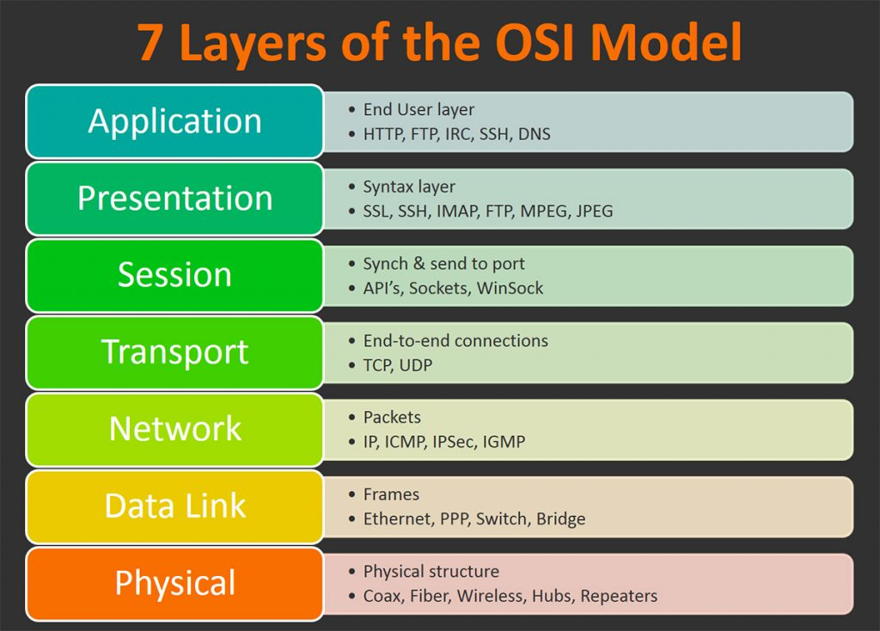

Slide 15
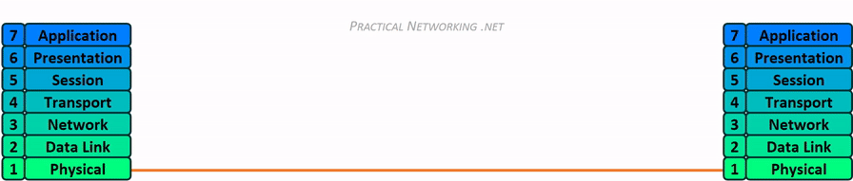
Network Transmission

Slide 16

Layer 1- Physical
Media Layer

Slide 17
Networking Hardware
Purpose
Provides a physical medium for transporting raw information
Wireless Antenna
Cat5 (Ethernet) Cables
Coaxial Cables
Fiber Optic Cables
Network Hubs
Network Repeaters

Slide 18

Layer 2 - Data Link
Media layer

Slide 19
Layer 2
Purpose
Provides error-free transfer of data frames from one node to another via the physical layer
Physical
Network Switch
Network Bridge
Logical
“Frames”

Slide 20
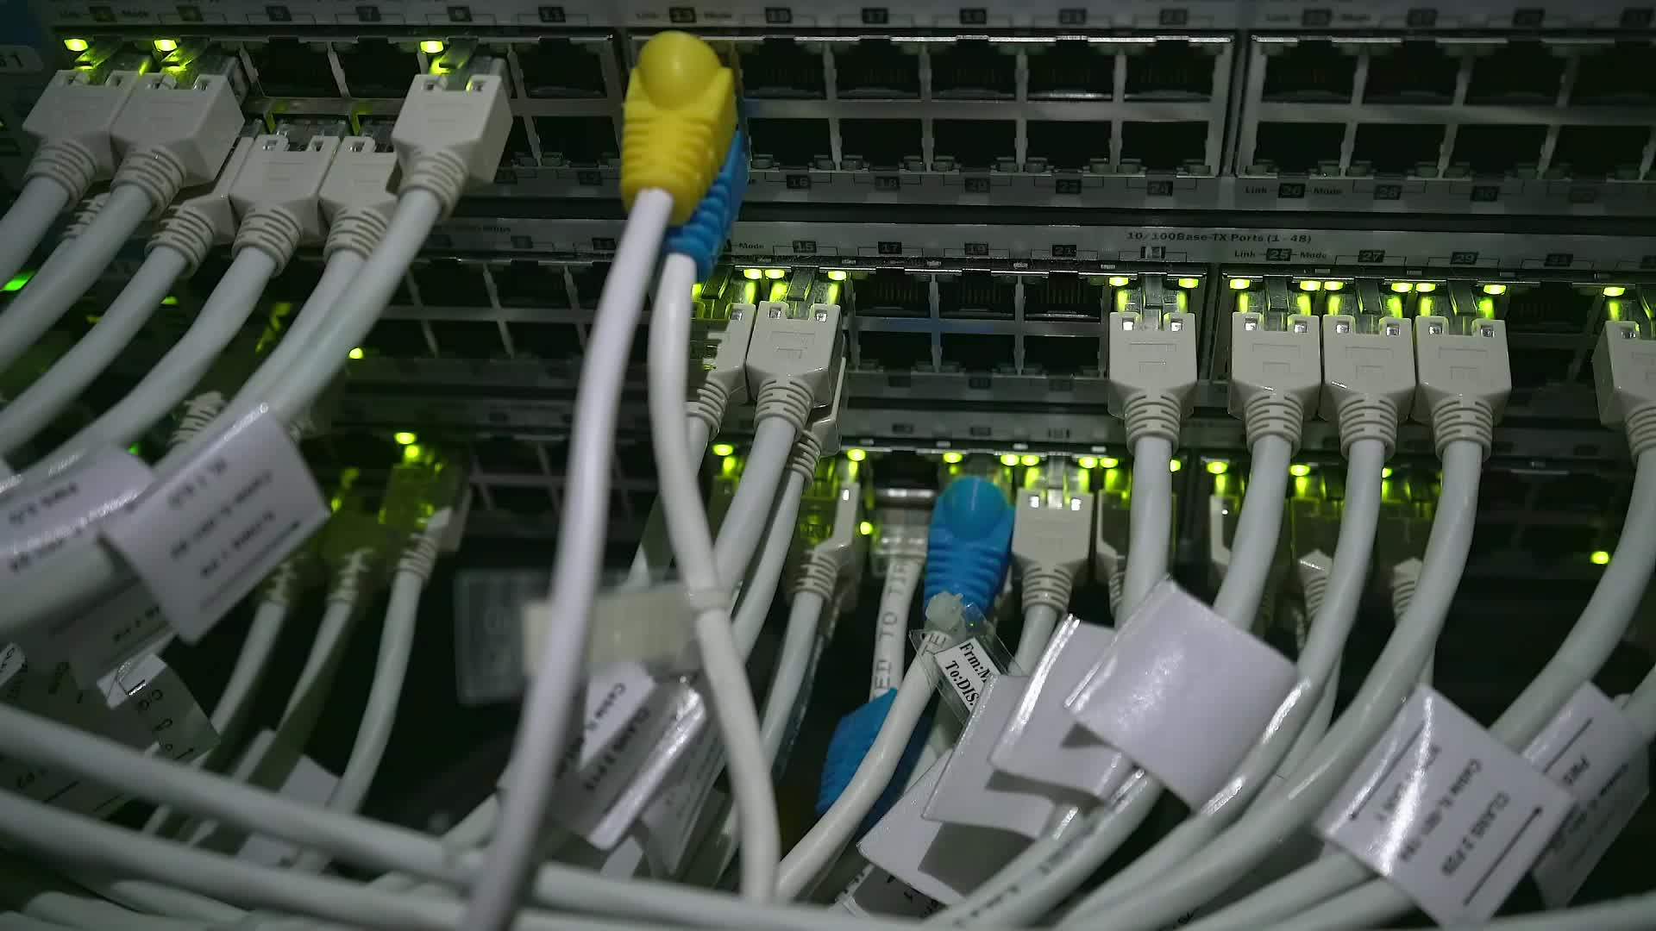
Layer 3 - Network
Media Layer

Slide 21
Layer 3
Purpose
Controls the operations of the subnet.
Decides which physical path data will take
Physical
Router
Logical (Protocols)
IP
ICMP
IPSec
IGMP

Slide 22
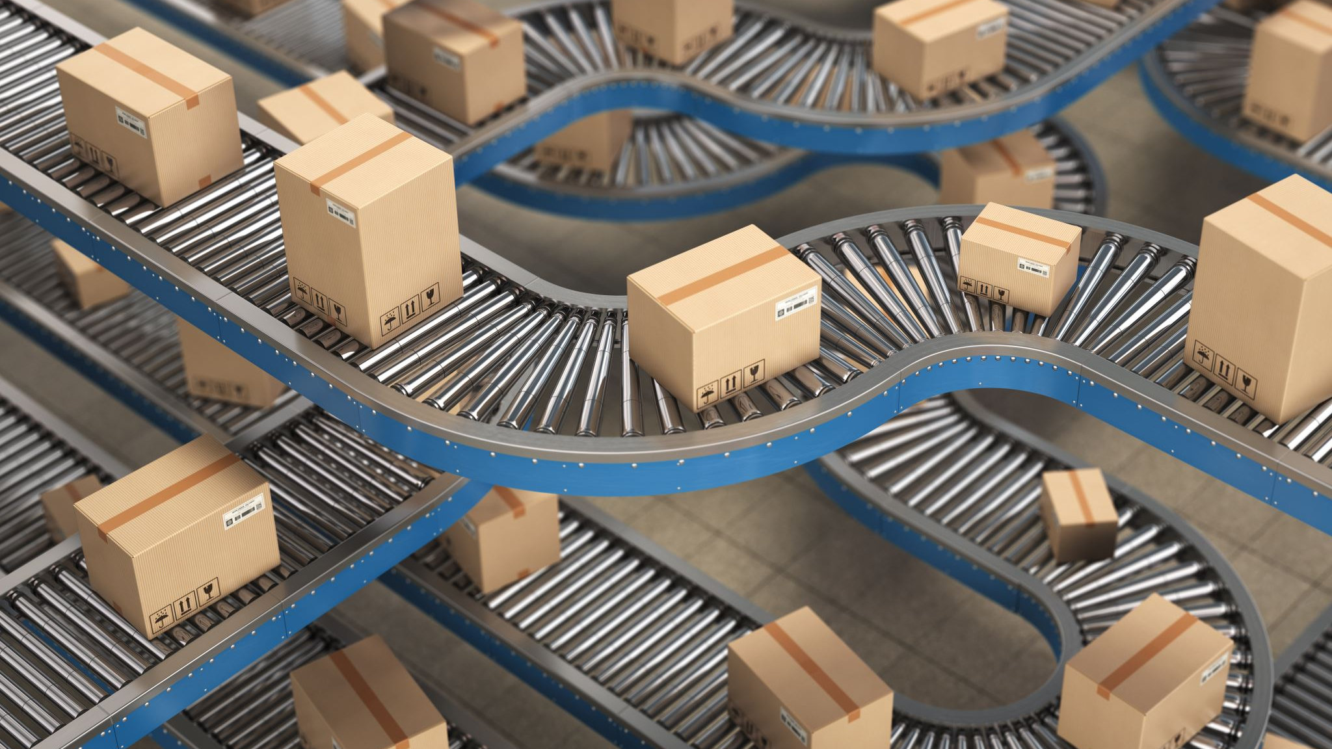
Layer 4 - Transport
Host Layer

Slide 23
Layer 4
Purpose
Ensures that messages are delivered in sequence without losses, errors or duplications
Logical
TCP
UDP

Slide 24
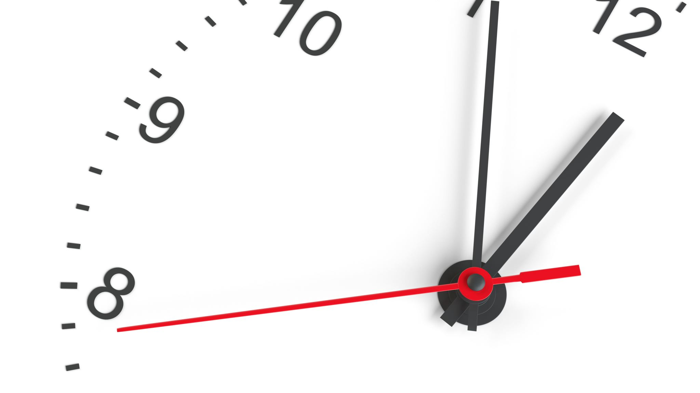
10 minute break

Slide 25
TCP VS. UDP

Slide 26
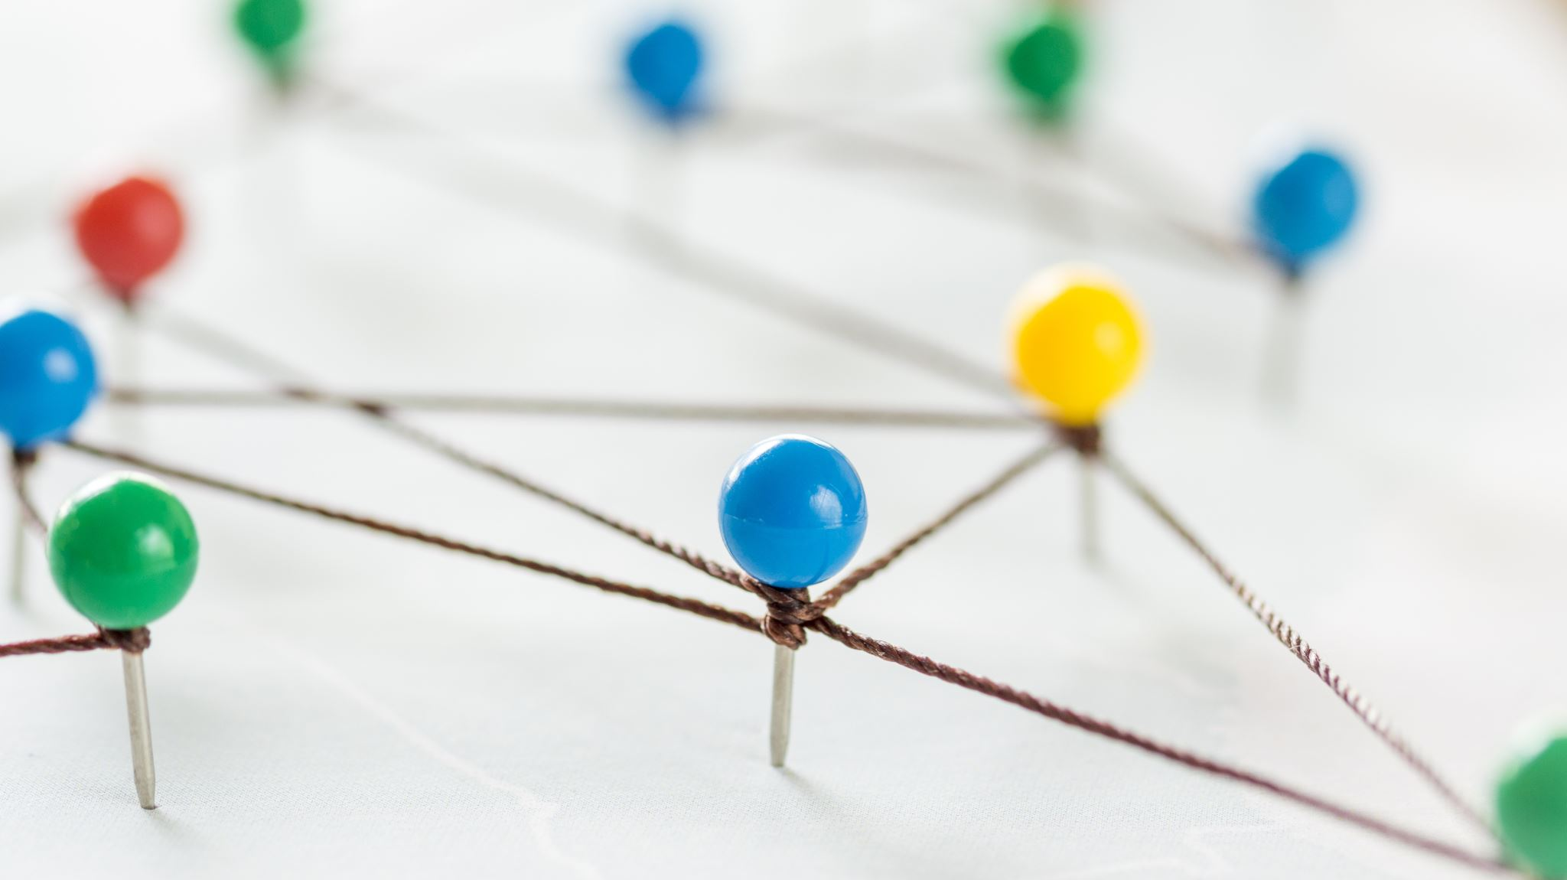
Stateful vs. Stateless Networking

Slide 27
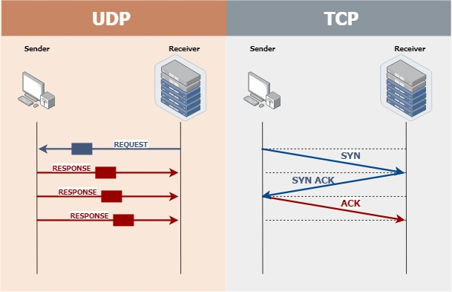

Slide 28
TCP Handling

Slide 29
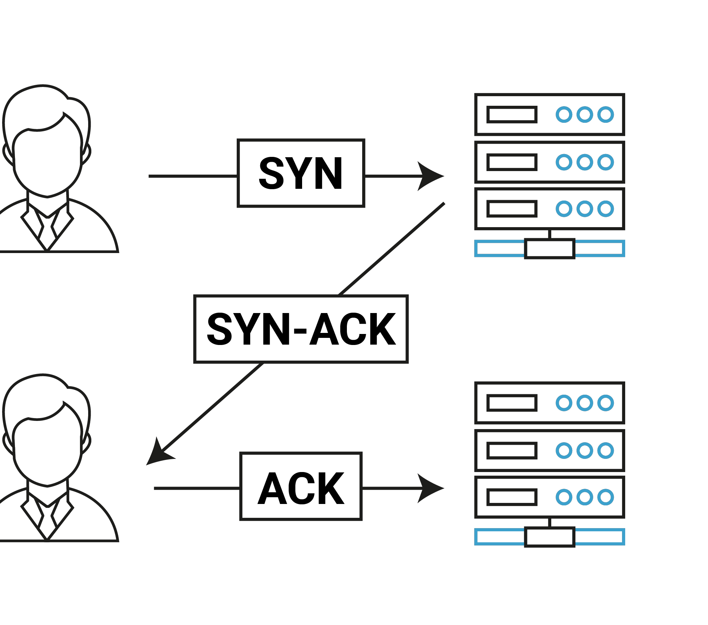
TCP 3-Way Handshake

Slide 30
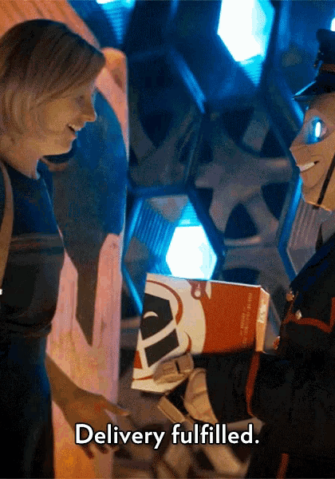
Explain TCP In A Gif

Slide 31
UDP Handling

Slide 32

Explain UDP In A Gif

Slide 33
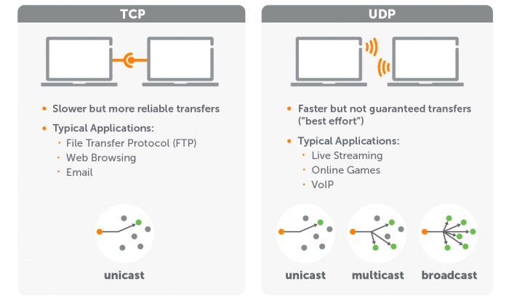

Slide 34
Discussion: TCP Apps & UDP Apps
Moodle
TCP or UDP?
VoIP
TCP or UDP?
YouTube
TCP or UDP?
SWIFT Money Transfers
TCP or UDP?

Slide 35
Layer 5 – Session
Host layer

Slide 36
Layer 5
Purpose
Allows the establishment of sessions between processes
Protocols
RPC
SQL
NFS
Netbios

Slide 37

Layer 6 – Presentation
Host layer

Slide 38
Layer 6
Purpose
Formats data bound for the application layer (layer 7)
Protocols
JPG
ASCII
ANSI
GIF
WEBP

Slide 39
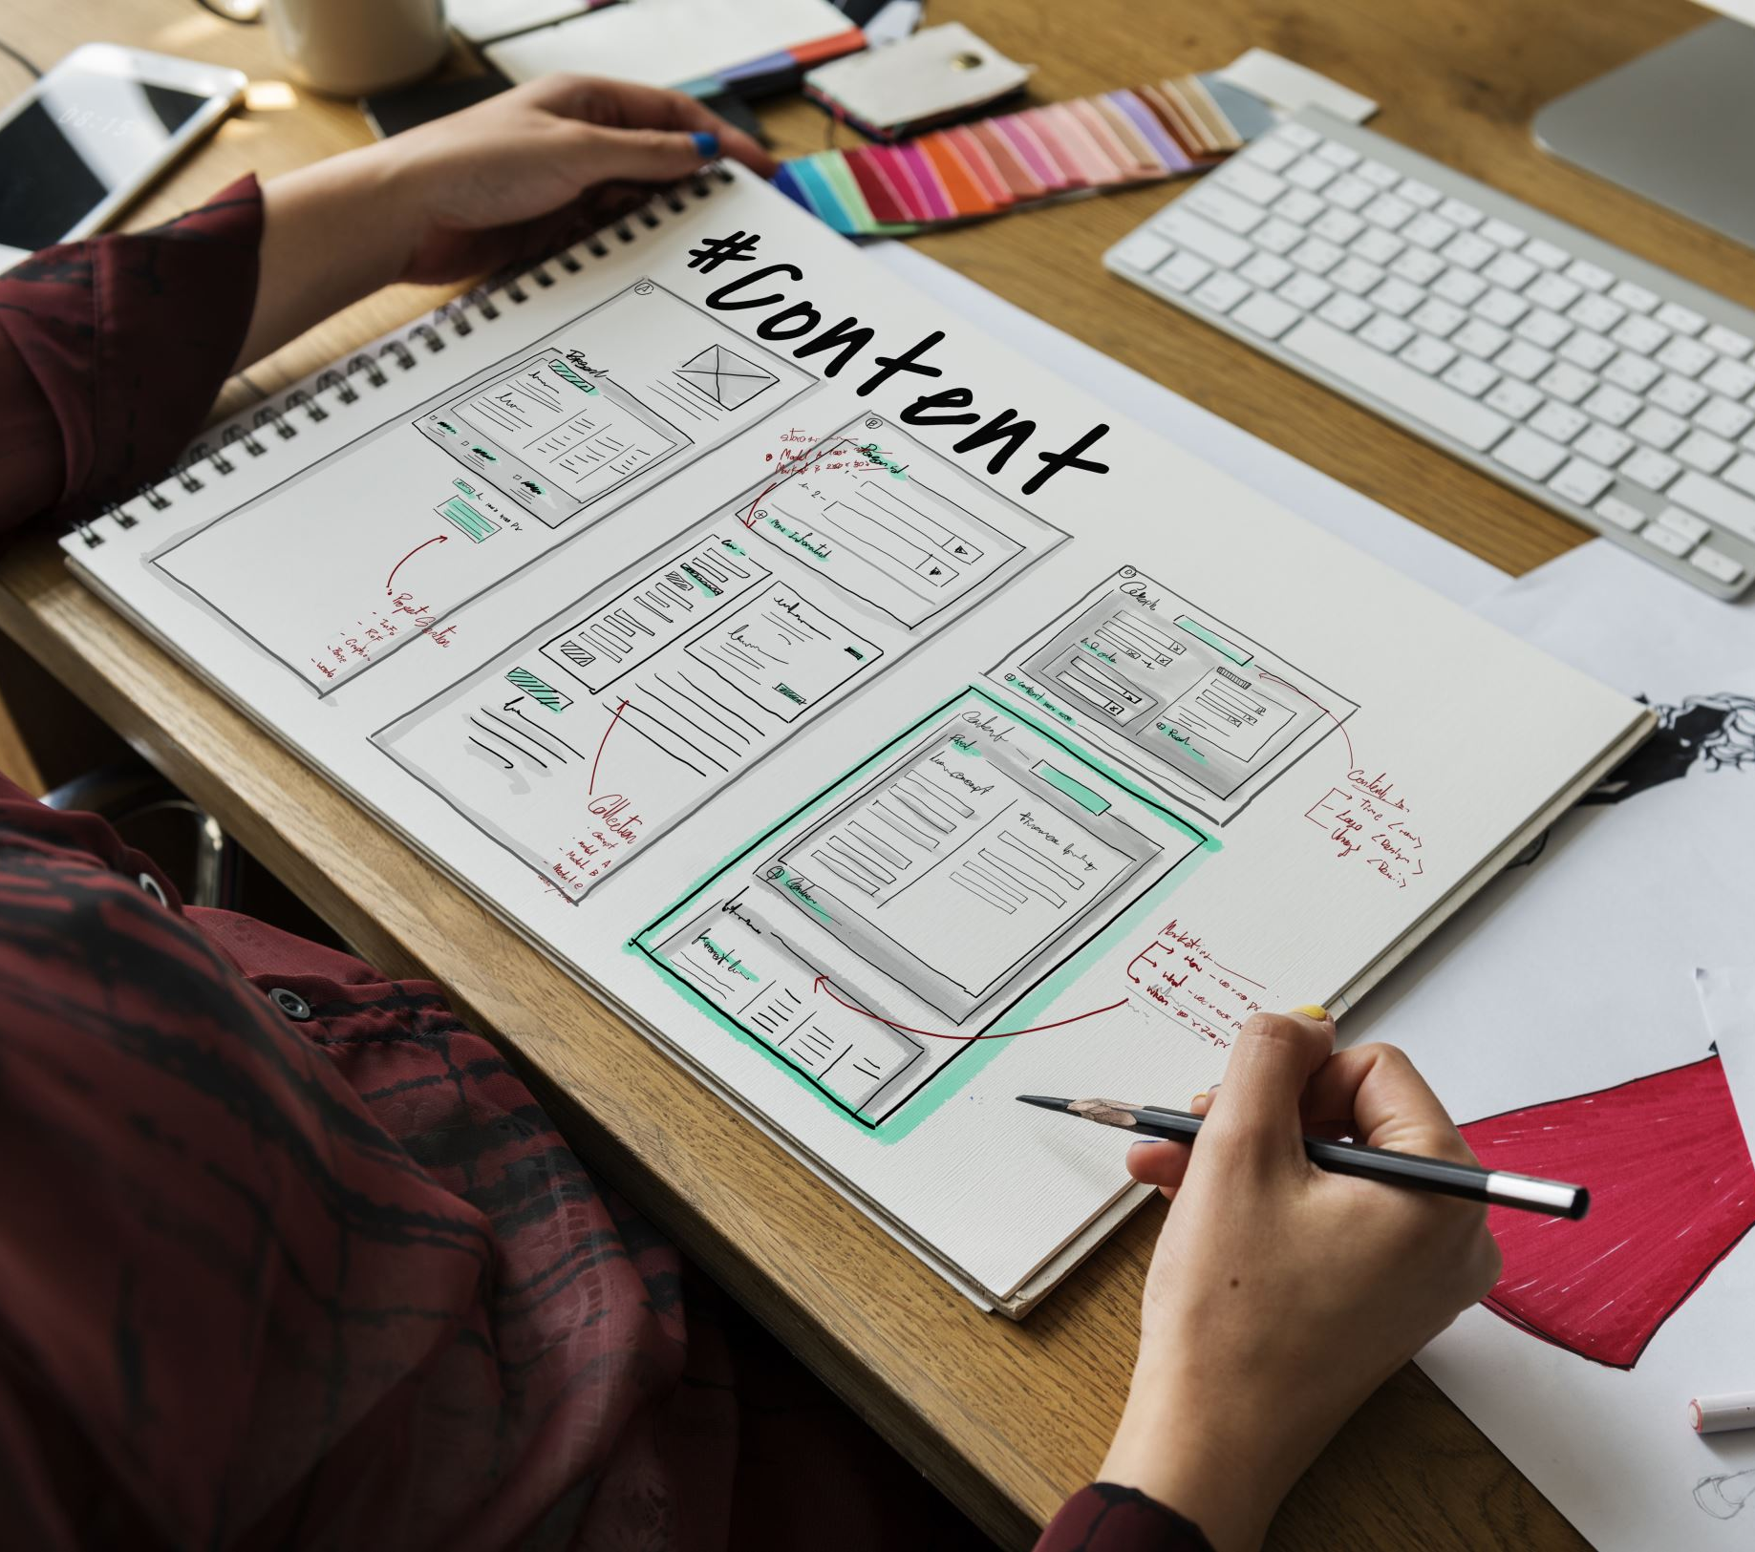
Layer 7 – Application
Host layer

Slide 40
Layer 7
Purpose
Interface layers for users to access network resources
Protocols
SMTP
HTTP
Wiki
Microsoft Word

Slide 41
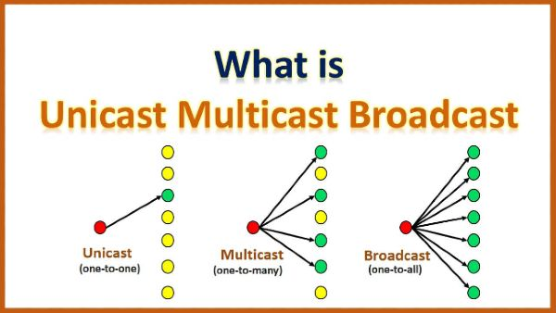

Slide 42

Shall We Play A Game?
https://static-labs.tryhackme.cloud/sites/osi-model-game/
Notes:
Let’s play a little network protocol game and see if we can remember the 7 layers of the OSI model!

Slide 43

Name Resolution

Slide 44
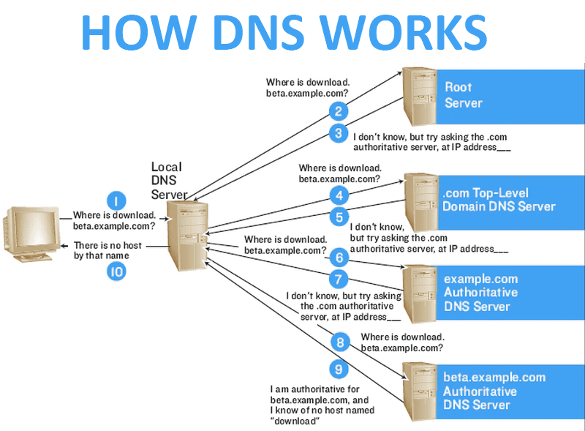
DNS

Slide 45

DNS: TCP or UDP?

Slide 46

Problem: How Do We Move Information?

Slide 47
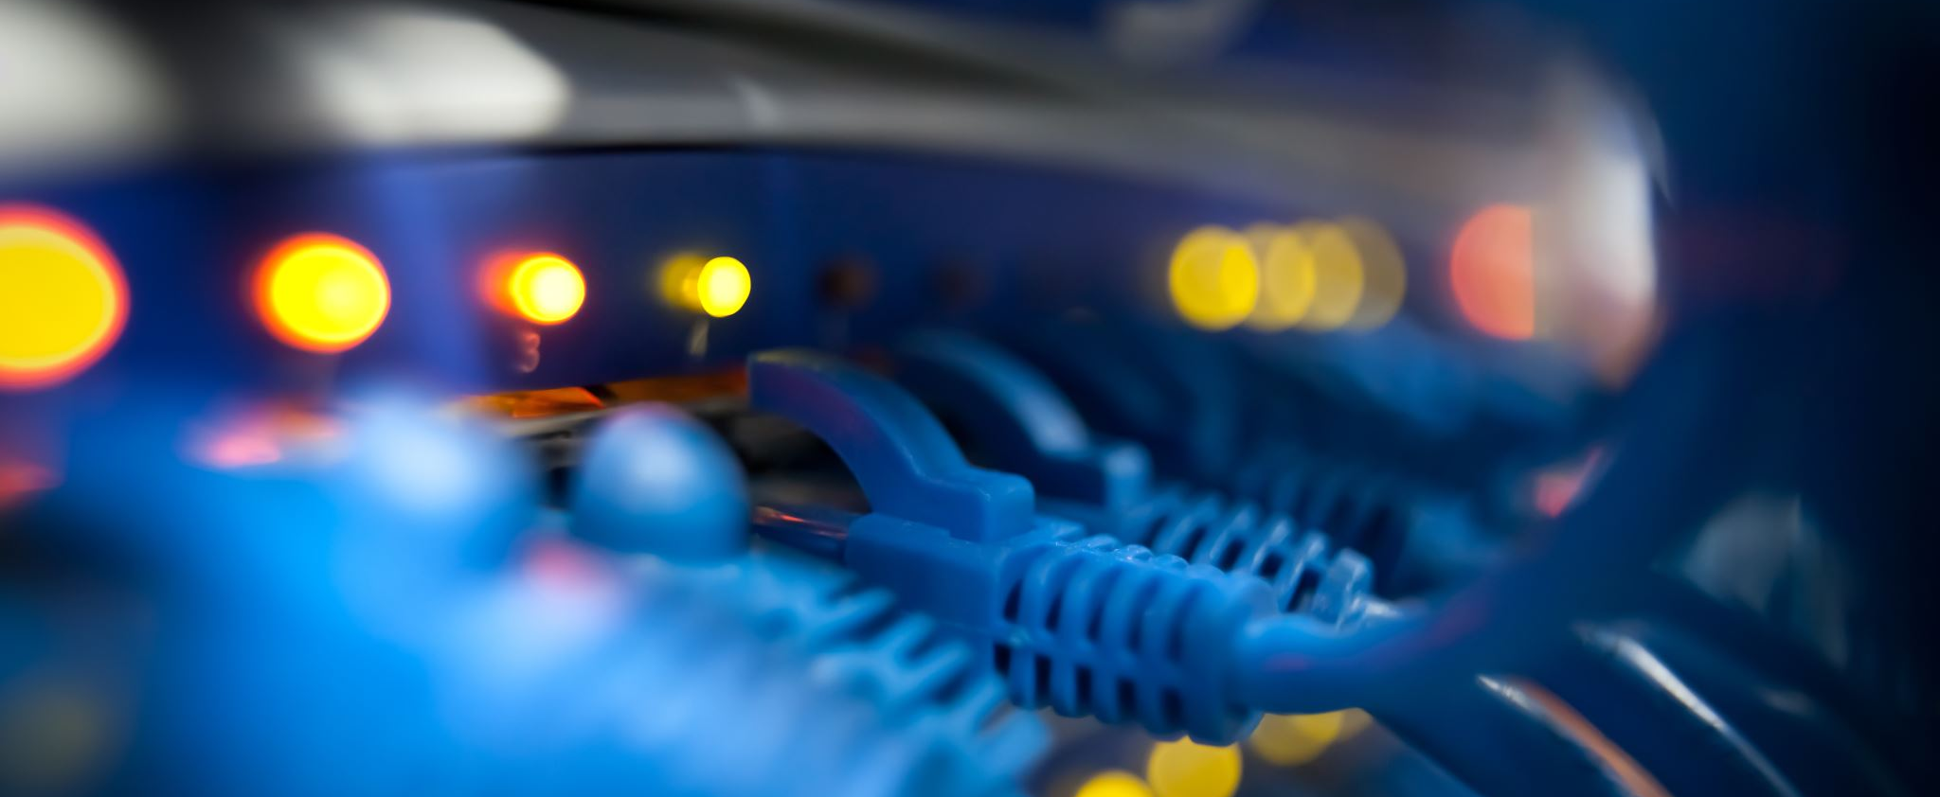
LANs and WANs

Slide 48
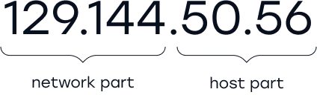
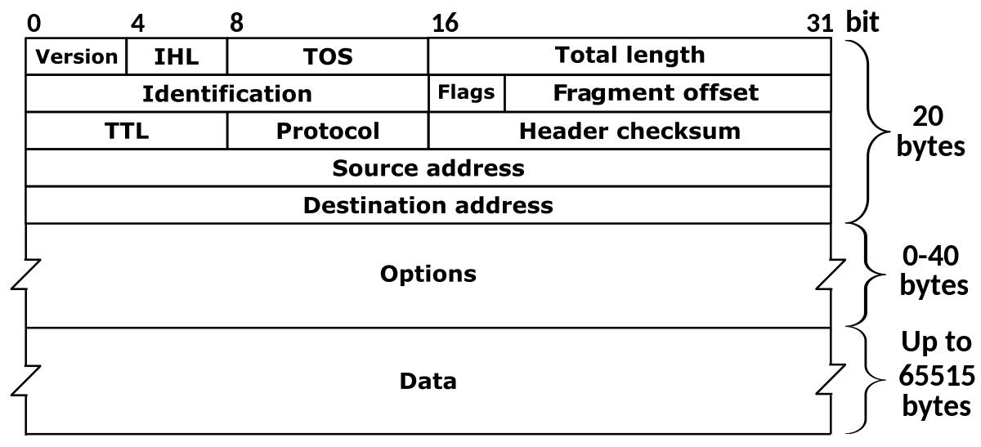
Network Operation

Slide 49
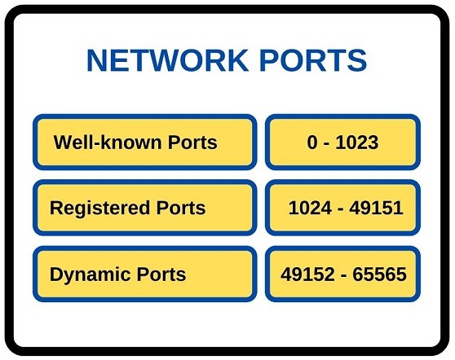
Network Ports

Slide 50
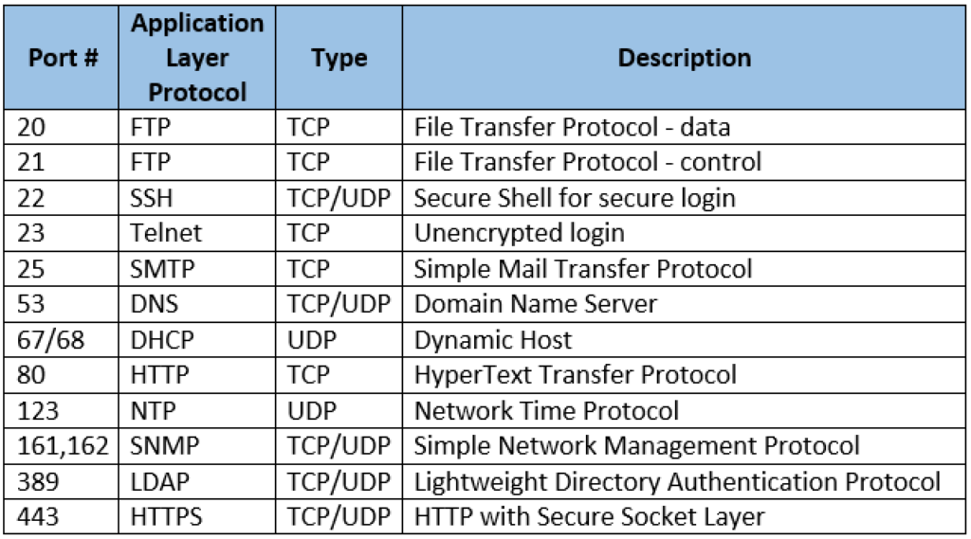
Common Ports

Slide 51
10 minute break

Slide 52
Local Area Network (LAN)
Allows connection to other nearby network-connected systems
You probably use some of these devices!
Amazon firestick
Google Chromecast
Apple TV
More protective of local information?

Slide 53
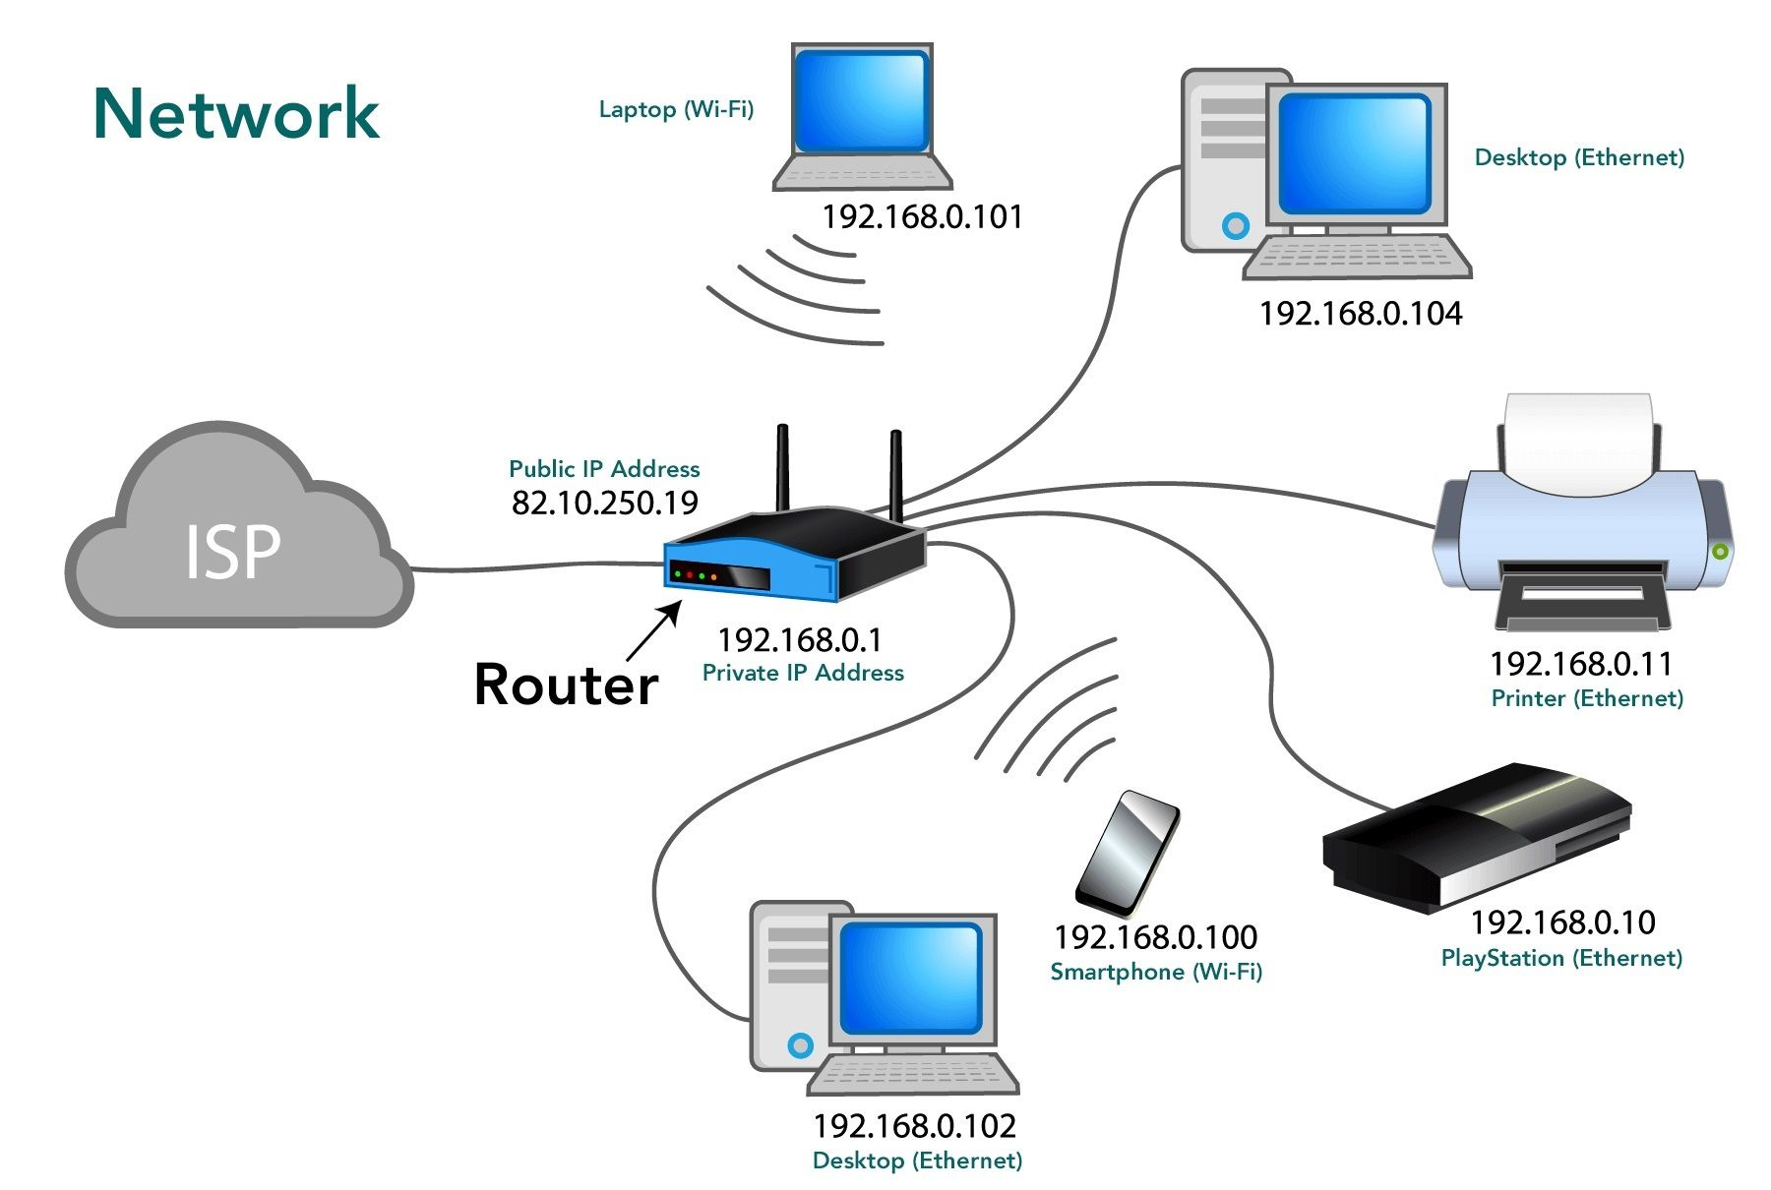
Basic Network Topology

Slide 54
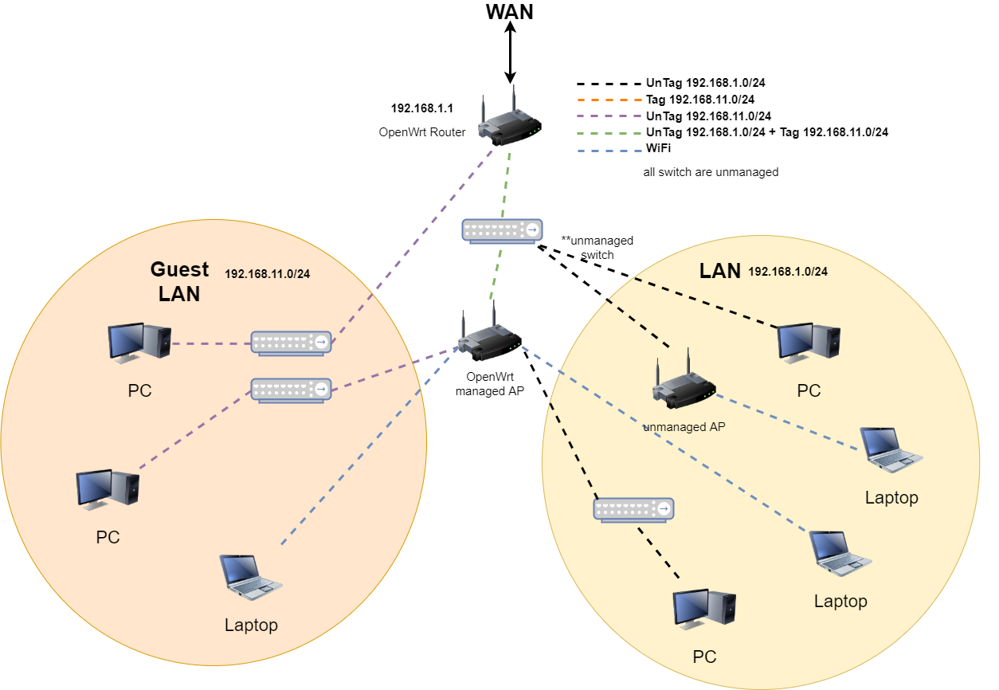

Slide 55
Wide Area Network (WAN)
Allows connection to remote hosts
Typically used to connect multiple geographic locations together
Think offices, homes, customers, etc.
Websites
Remote backups/repositories
VPNs enable access to remote LANs

Slide 56
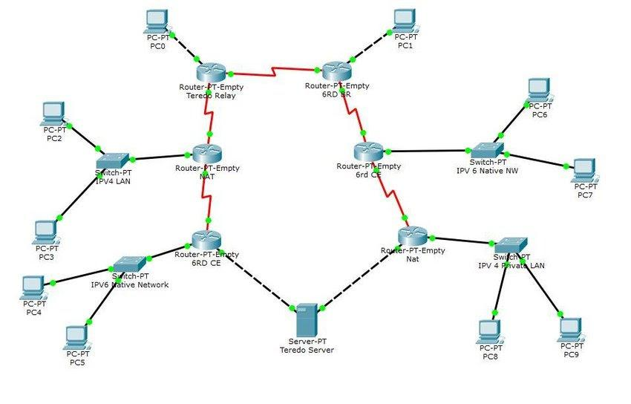
Complex Network Topology

Slide 57
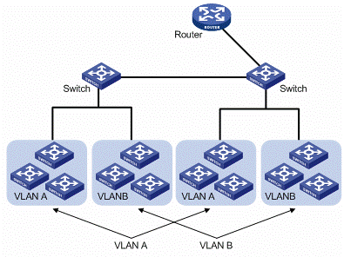
LANs and VLANs

Slide 58
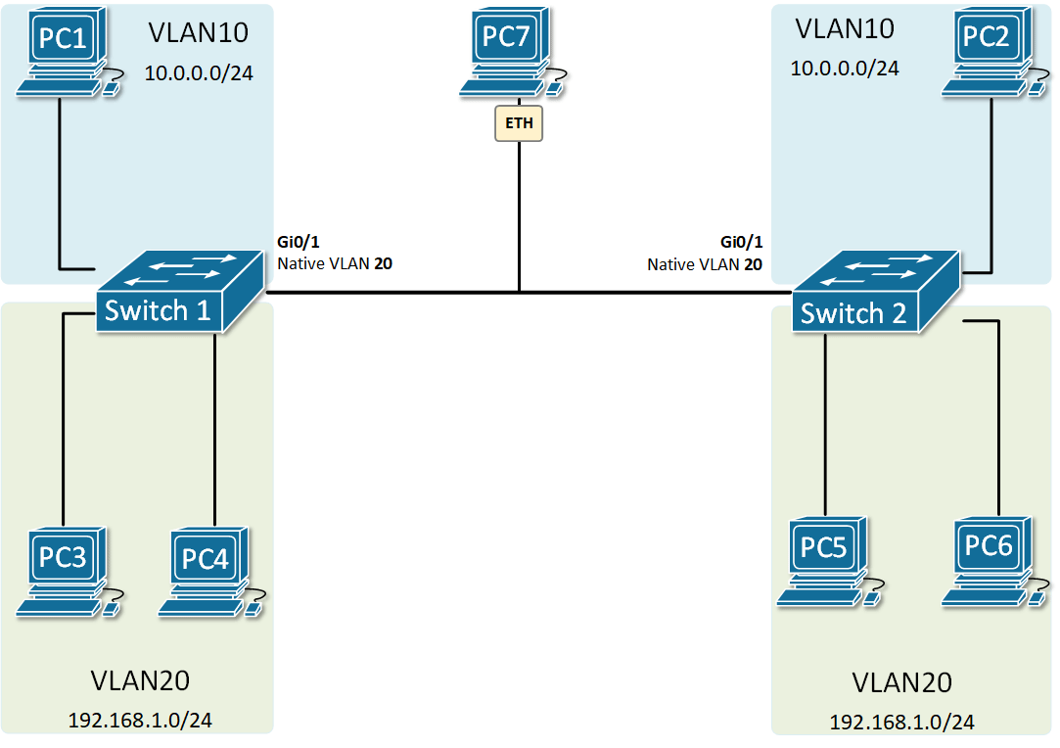
Trunk Native VLAN

Slide 59

How Do Apps Access Information?

Slide 60
Local & Remote Information
Local filesystem
Remote filesystem
Repositories
Databases
Local hard drive
Hard drive on another computer
Structured data
Typically holds frequently changing information
SQL, MSAccess, etc.

Slide 61
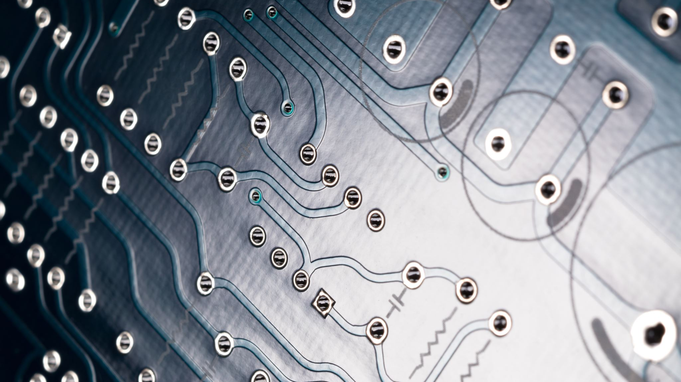
Software Underpins All Of This!

Slide 62
Day 2 Recap

Slide 63
Question or Clarifications?

Slide 64
Day 3 Preview

Slide 65
Instructor Contact Info
ecrose@oakland.edu

